Slide 1
Research topic
Scale:
Talk about how software system grow lot over the past decade
How do we deal with million requirements?
Example: Autocar, Smart home
Light management
Energy management
Smart home system
Access control

Slide 2
Research topic
Security / Safety & fault tolerance:
- Authentication: network nodes, network application API;
- Key agreemen;
- IPSec; SSL/TLS; SSH; Kerberos

Slide 3
Research topic
Authentication
- Public key (Certificate) approach
- Prior secret-shared approach
Key agreement
- Diffie-hellman key exchange
Secure protocol deployment
- Chosent layer to implement
- Chosen cipher to encrypt exchange data
Some example secure protocols

Slide 4
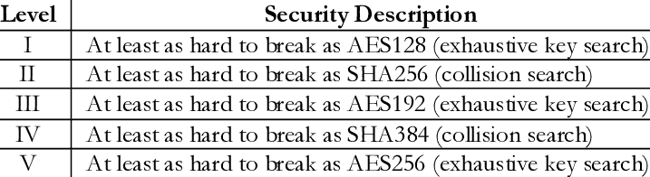
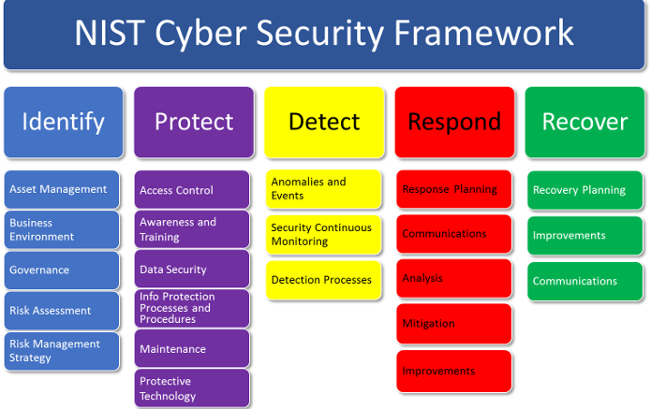
Research topic
Knowing NIST security level

Slide 5
Research topic
Increased reliance on environment
Self – management & AI
Globalization
Requirements reuse

